Slide 1
Flying Whale Insights & Analysis By: Monica 29-04-2024

Slide 2

Agenda
Introduction
Report Dashboards
Future Recommendations

Slide 3
INTRODUCTION
Flying Whale Airline, a prominent (fictional) international airline, seeks to enhance its business intelligence capabilities by analyzing Customer Flight Activity and Customer Loyalty History. The airline is committed to optimizing customer experience, understanding travel patterns, and maximizing the effectiveness of its loyalty programs.

Slide 4
REPORT DASHBOARD
After cleaning and analyzing the dataset.
The analysis explores the distribution of memberships across the country, and gender providing valuable insights into customer demographics and engagement.
The following visualizations have been carried out based on the data provided:

Slide 5
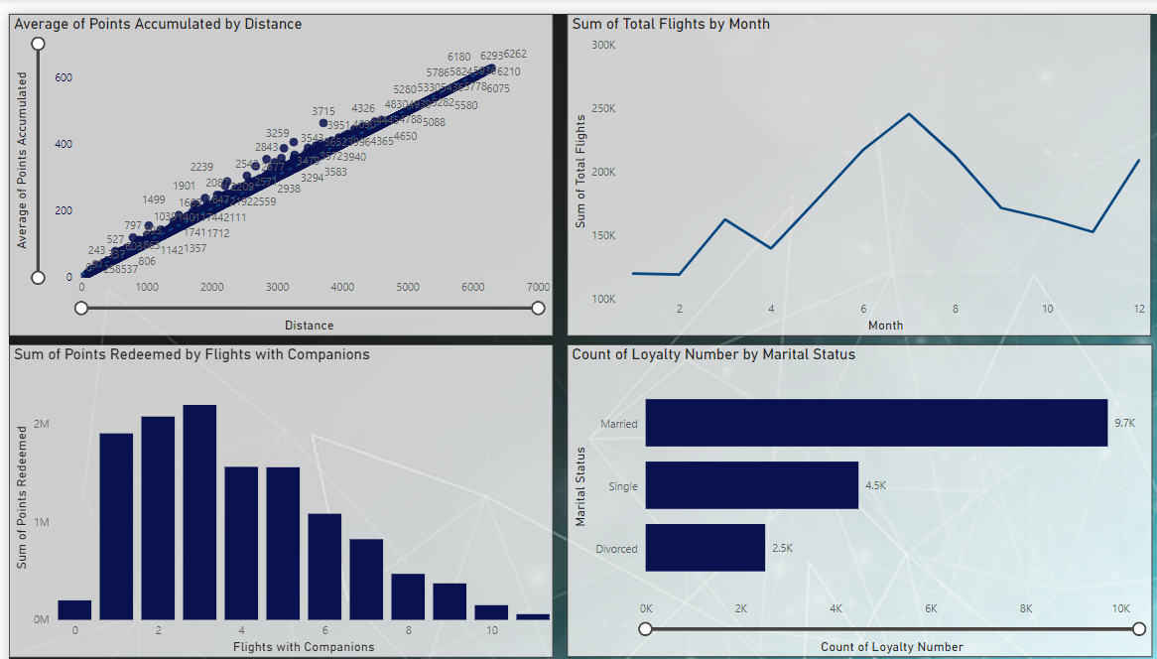

Slide 6
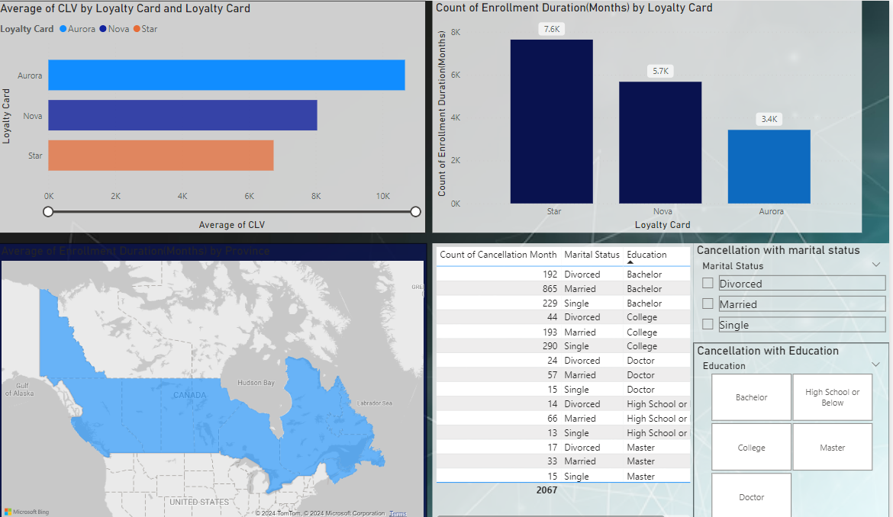
Demographic representation of the insights

Slide 7

Future Recommendation:
Given below are some of the recommendations evaluated after visualizing:
Married couples tend to travel the most, so special and limited services should be announced to attract them.
People with Aurora membership tend to be the ones who have not canceled their membership.
Students with bachelor’s education are the ones that travel the most, student membership can improve the marketing and the rate of increase in loyalty will also go high.
The total sum of flights booked by men is more than that of women. Keeping men entertained during the flight with movies, good food, and games can also be beneficial.

Slide 8
Thank you
Monica
imabhattii@gmail.com
http://www.linkedin.com/in/monica-bhatti

